Slide 1



Blinkit Grocery Data AnalysisVV
PROJECT MEMBER
Manikandan M [22ADR062]
Aswin K S [22ADR012]
Kishore S [22ADR054]
PROJECT GUIDE
Ms.O.Abhila Anju
Associate Professor Department of AI

Slide 2
REVIEW 3 SYNOPSIS
INTRODUCTION
DATASET
PREPROCESSING
MODEL VIEW
VISUALIZATION
DAX QUERY
PUBLISHED REPORT
CONCLUSION

Slide 3
INTRODUCTION
The BlinkIT Grocery dataset serves as a comprehensive source of information to analyze key performance indicators (KPIs) within the grocery retail sector.
By analyzing this dataset, we aim to uncover insights into product performance, customer buying patterns, demand forecasting, and supply chain efficiency.
Using Power BI for this analysis will enable dynamic data visualization and facilitate a deeper understanding of the relationships between different metrics.
The insights derived from this analysis can contribute to increasing sales, enhancing customer satisfaction, and improving the overall efficiency of BlinkIT’s grocery retail business.

Slide 4
DATASET
BLINKIT DATA
LINK :
https://docs.google.com/spreadsheets/d/1rSMTk_tlu9Zx-9qSV71U4LIhIffcjyfi/edit?usp=drive_link&ouid=104559031799129406295&rtpof=true&sd=true
BLINKIT DATA 2
LINK :
https://docs.google.com/spreadsheets/d/15UlYn-9CKLbOcXFAR4DOolN6BH5fROln/edit?usp=drive_link&ouid=104559031799129406295&rtpof=true&sd=true
BLINKIT DARK STORE
LINK :
https://docs.google.com/spreadsheets/d/1v-mAoIbbn3HZBXSqhr5Ez_U1rUoyrUWa/edit?usp=drive_link&ouid=104559031799129406295&rtpof=true&sd=true
BLINKIT OIL AND DRY FRUITS
LINK : https://drive.google.com/file/d/1bO9KnxX3l_EwkvqCXzY8GRukXGU6dvMu/view?usp=drive_link

Slide 5
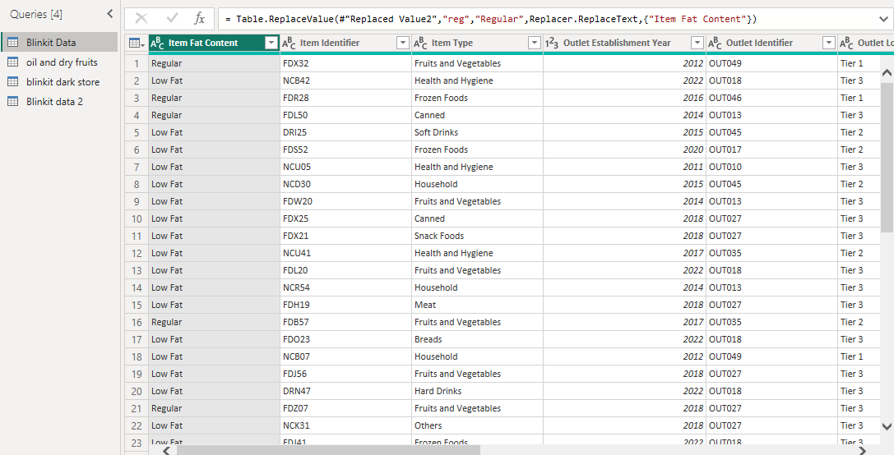
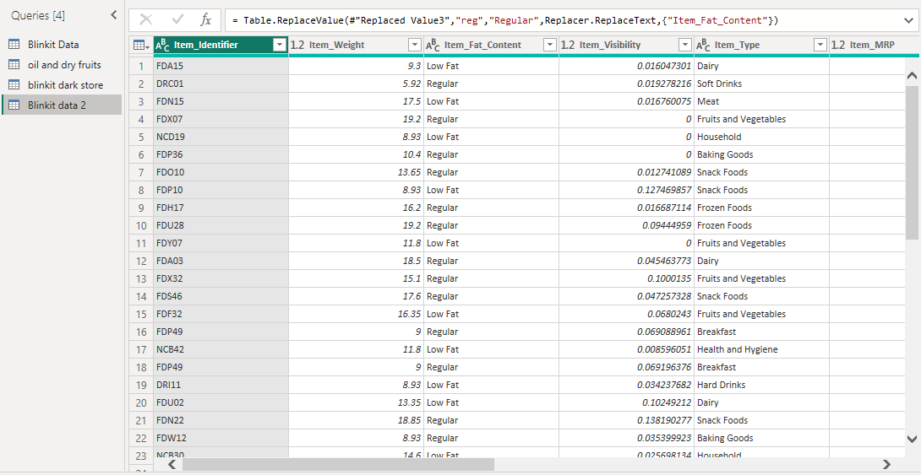

Slide 6
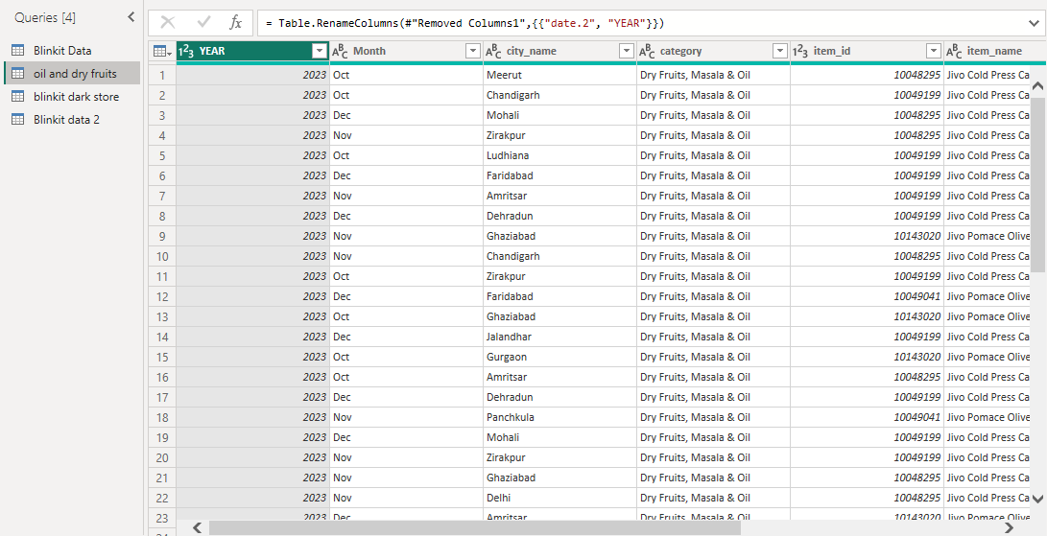
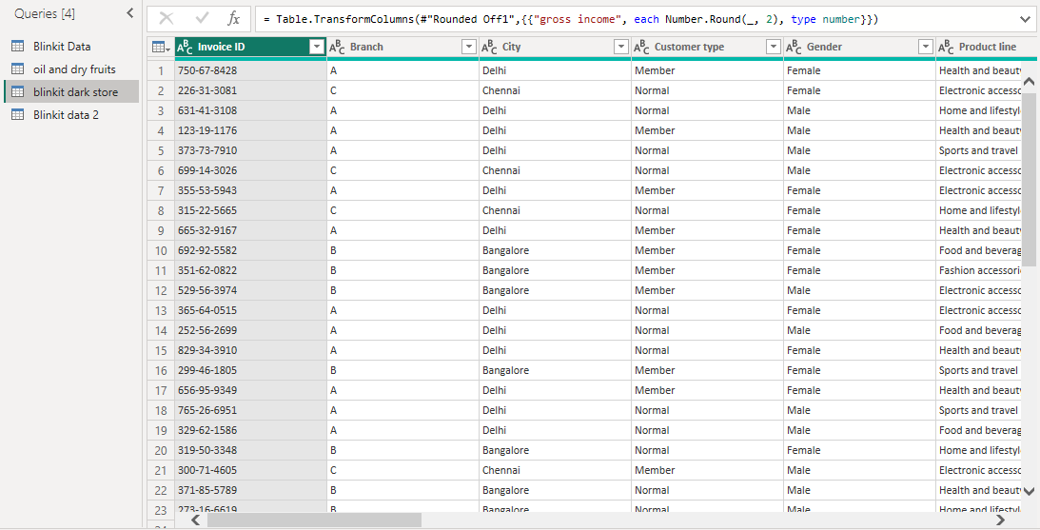

Slide 7
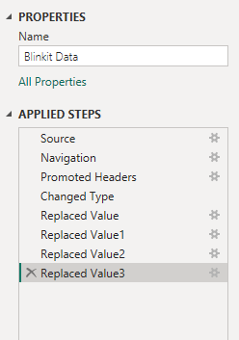
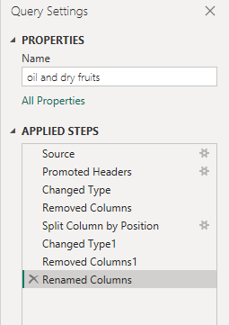
PREPROCESSING

Slide 8
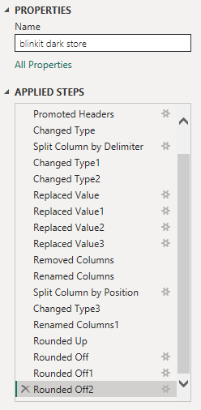
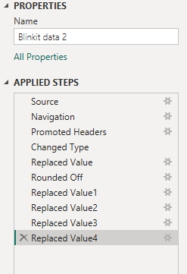

Slide 9
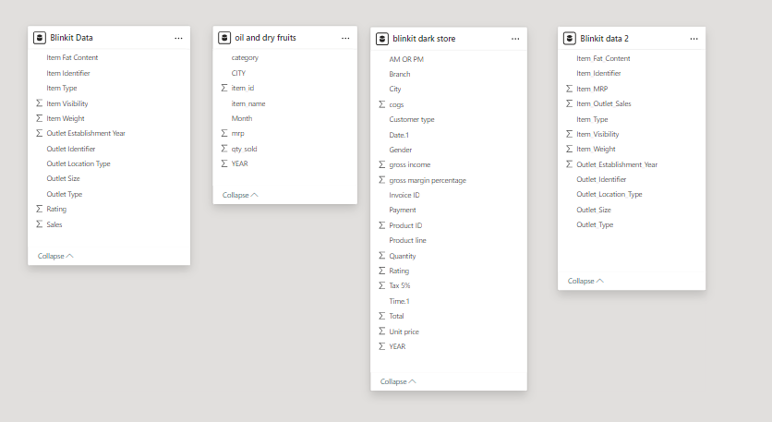
MODELVIEW

Slide 10
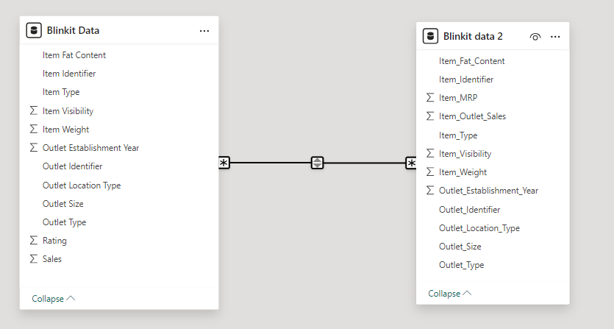
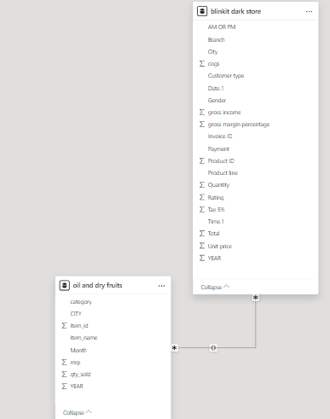
RELATIONSHIPS

Slide 11
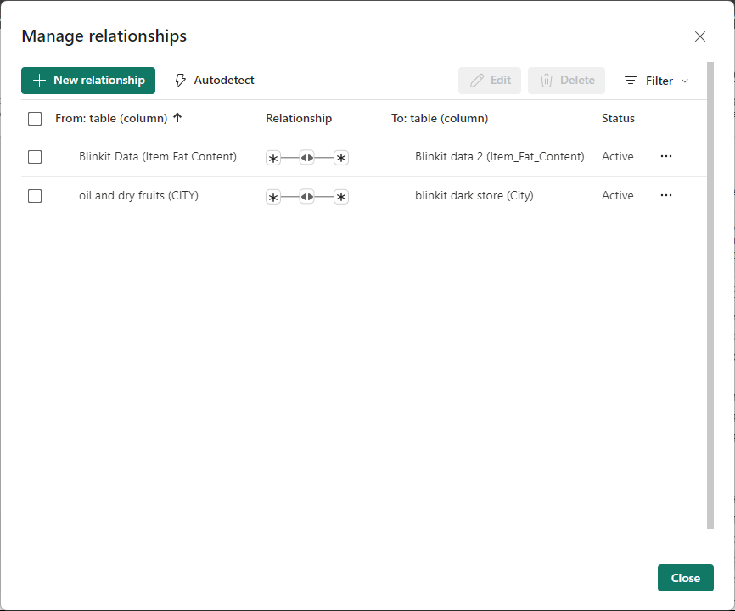
RELATIONSHIPS

Slide 12
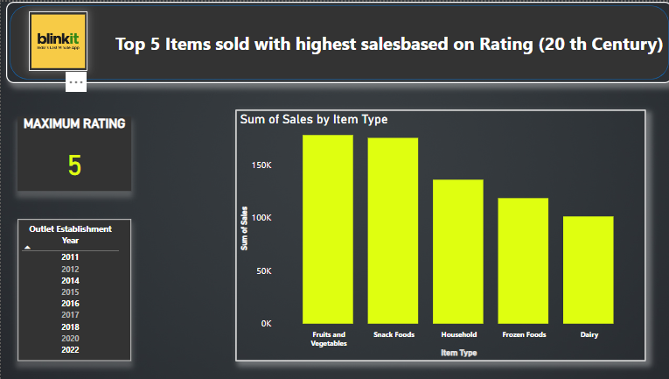
VISUALIZATION
1.Top 5 Items sold with highest salesbased on Rating (20 th Century)
DAX QUERY : maximum rating = MAX('blinkit 20''s'[Rating])

Slide 13
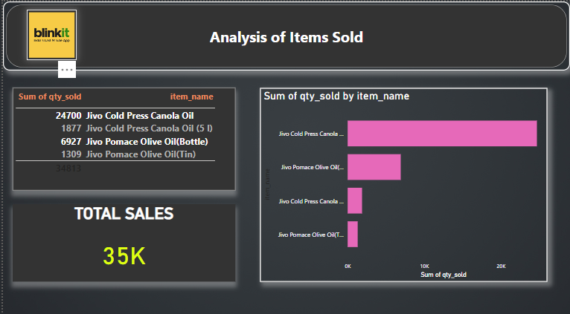
VISUALIZATION
2. Analysis of Items Sold

Slide 14
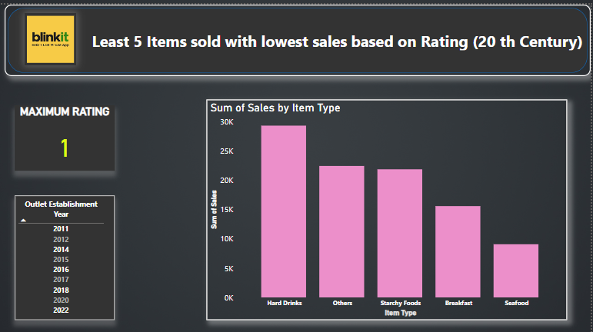
VISUALIZATION
3. Least 5 Items sold with lowest sales based on Rating (20 th Century)
DAX QUERY : minrating = MIN('blinkit 20''s'[Rating])

Slide 15
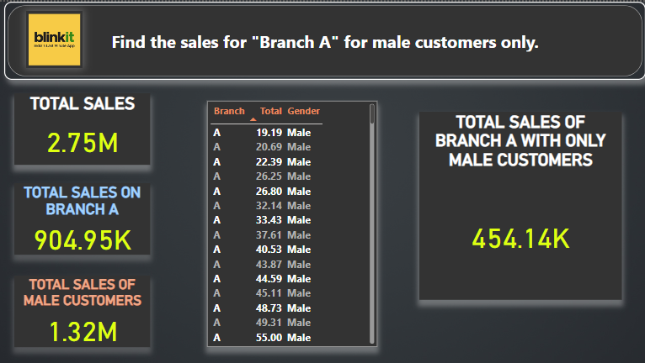
4.Find the sales for "Branch A" for male customers only.
DAX QUERY :
Male = IF('blinkit dark store'[Gender] = "Male", 1, 0)
Branch A=IF('blinkit dark store’[Branch] = “A", 1, 0)

Slide 16
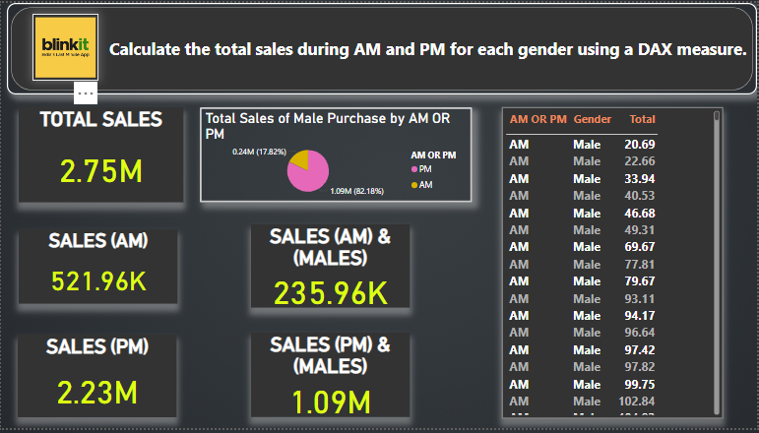
5.Calculate the total sales during AM and PM for gender Male using a DAX measure.
DAX QUERY :
AM = IF('blinkit dark store'[AM OR PM] = "AM", 1, 0)
PM = IF('blinkit dark store'[AM OR PM] = “PM", 1, 0)
Male = IF('blinkit dark store'[Gender] = "Male", 1, 0)

Slide 17
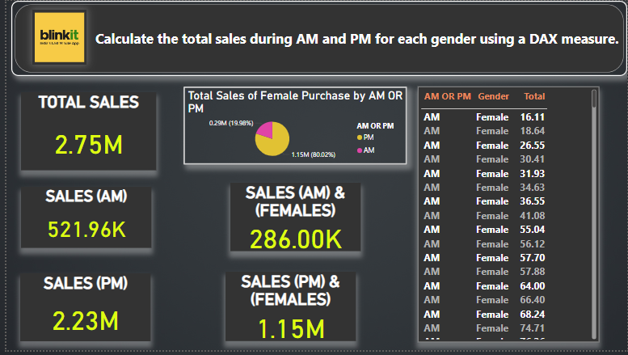
6.Calculate the total sales during AM and PM for gender Female using a DAX measure.
DAX QUERY :
AM = IF('blinkit dark store'[AM OR PM] = "AM", 1, 0)
PM = IF('blinkit dark store'[AM OR PM] = “PM", 1, 0)
Female = IF('blinkit dark store'[Gender] = “Female", 1, 0)

Slide 18
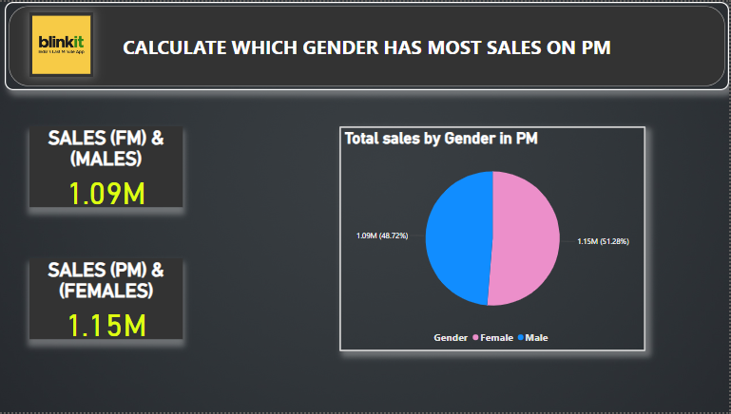
7.CALCULATE WHICH GENDER HAS MOST SALES ON PM
DAX QUERY : maximum rating = MAX('blinkit 20''s'[Rating])

Slide 19
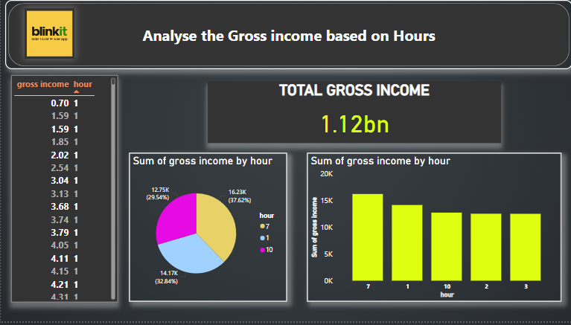
8.Analyse the Gross income based on Hours
DAX QUERY :
totalgross = SUM('blinkit dark store'[gross income])

Slide 20
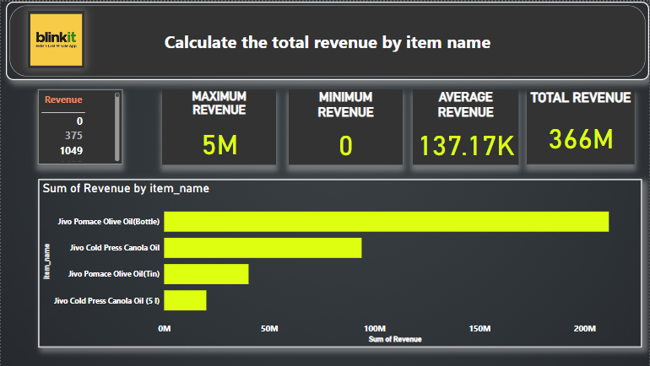
9.Calculate the total revenue by item name
DAX QUERY :
Revenue = 'oil and dry fruits'[mrp] * 'oil and dry fruits'[qty_sold]
TOTALREVENUE = SUM('oil and dry fruits'[Revenue])
MAXREVENUE = MAX('oil and dry fruits'[Revenue])
MINREVENUE = MIN('oil and dry fruits'[Revenue])

Slide 21
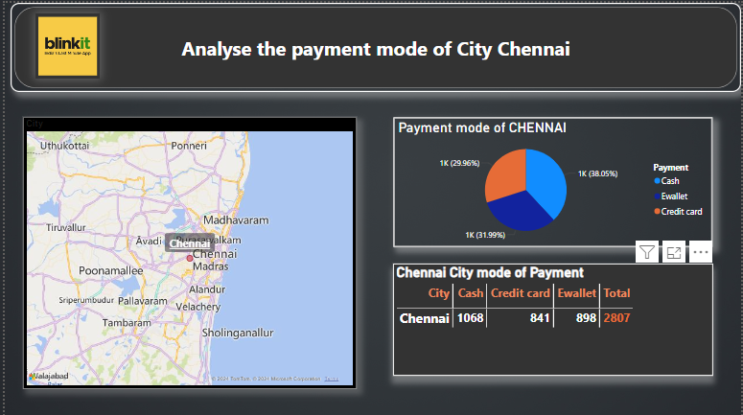
10.Analyse the payment mode of City Chennai
DAX QUERY :
CHENNAI = IF('blinkit dark store'[City] = "Chennai", 1, 0)

Slide 22
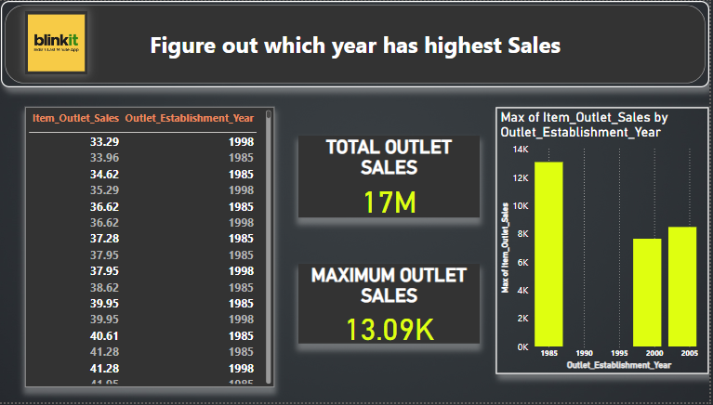
11.Figure out which year has highest Sales
DAX QUERY :
maxsales = MAX('blinkit 90''s'[Item_Outlet_Sales])
totalsales = SUM('blinkit 90''s'[Item_Outlet_Sales])

Slide 23
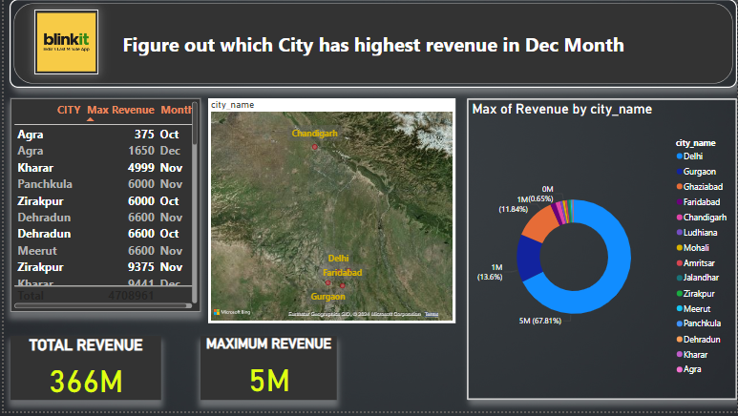
12.Figure out which City has highest revenue in Dec Month.
DAX QUERY :
Revenue = 'oil and dry fruits'[mrp] * 'oil and dry fruits'[qty_sold]

Slide 24
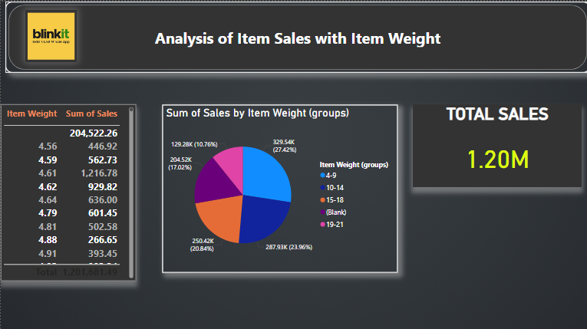
13.Analysis of Item Sales with Item Weight.
DAX QUERY :
TOTSALES = SUM('blinkit 20''s'[Sales])

Slide 25
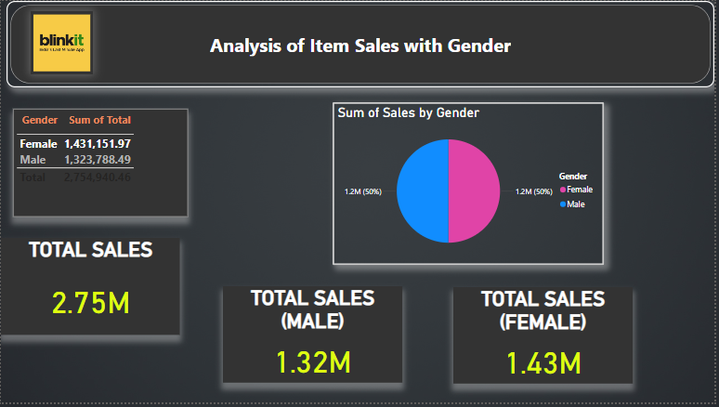
14.Analysis of Item Sales with Gender
DAX QUERY :
TOTSALES = SUM('blinkit 20''s'[Sales])
Male = IF('blinkit dark store'[Gender] = "Male", 1, 0)
Female = IF('blinkit dark store'[Gender] = “Female", 1, 0)

Slide 26
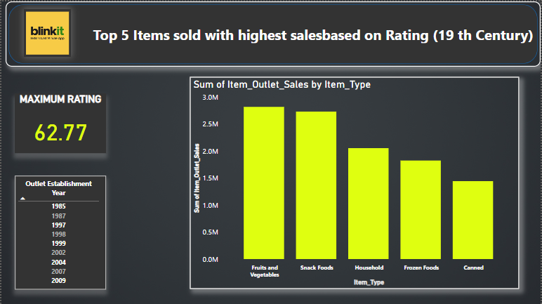
15. Top 5 Items sold with highest salesbased on Rating (19 th Century)
DAX QUERY :
Rating 1 =
CALCULATE(AVERAGE('blinkit 90''s'[Item_Outlet_Sales]) /(AVERAGE('blinkit 90''s'[Item_MRP]) * (1 - AVERAGE('blinkit 90''s'[Item_Visibility]))))
maxrating = MAX('blinkit 90''s’[Rating])

Slide 27
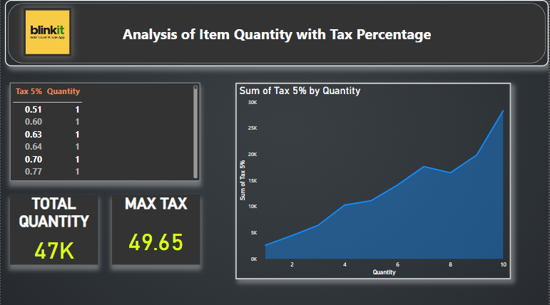
16.Analysis of Item Quantity with Tax Percentage
DAX QUERY :
maximum rating = MAX('blinkit 20''s'[Rating])

Slide 28
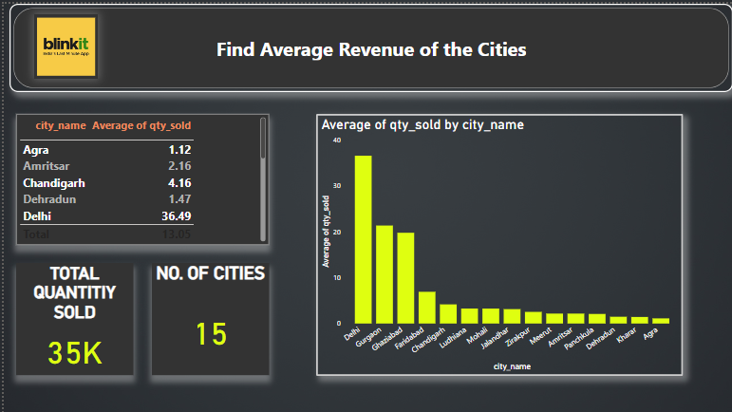
17. Find Average Revenue of the Cities
DAX QUERY :
totquantitysold = SUM('oil and dry fruits'[qty_sold])

Slide 29
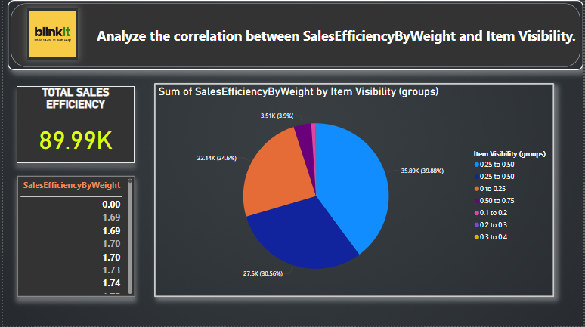
18. Analyze the correlation between SalesEfficiencyByWeight and Item Visibility.
DAX QUERY :
SalesEfficiencyByWeight = DIVIDE([Sales], [Item Weight], 0)

Slide 30
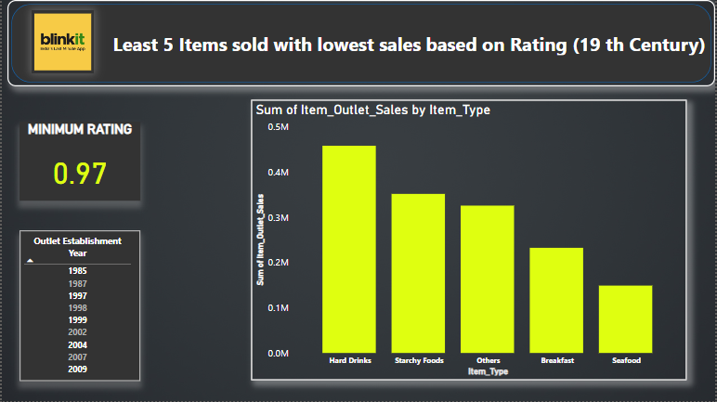
19. Least 5 Items sold with lowest sales based on Rating (19 th Century)
DAX QUERY :
Rating 1 =
CALCULATE(AVERAGE('blinkit 90''s'[Item_Outlet_Sales]) / (AVERAGE('blinkit 90''s'[Item_MRP]) * (1 - AVERAGE('blinkit 90''s'[Item_Visibility]))))

Slide 31
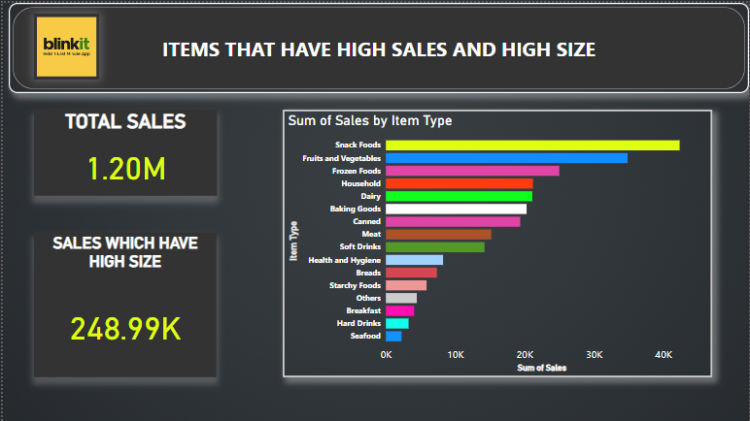
20.ITEMS THAT HAVE HIGH SALES AND HIGH SIZE
DAX QUERY :
HighOutletSize = IF('blinkit 20''s'[Outlet Size] = "High", 1, 0)
TOTSALES = SUM('blinkit 20''s'[Sales])
HIGHSALES = MAX('blinkit 20''s'[Sales])

Slide 32
INFERENCES
Top 5 Items sold with highest salesbased on Rating (20 th Century)?
The highest rating is 5 in 20 th Century.
The Top 5 items sold are Fruits and vegetables , Snack foods,Household,Frozen foods,Dai
Analysis of Items Sold
The 4 items sold are :
Jivo Cold Press Canola Oil (24700 qty sold)
Jivo Cold Press Canola Oil 5 I (187 qty sold)
Jivo Pomace Olive Oil bottle (6927 qty sold)
Jivo Pomace olive oil tin (1309 qty sold)
Total sales sold are 35 K
Least 5 Items sold with lowest sales based on Rating (20 th Century)?
The minimum rating is 1.
The 5 items which got least rating are:
Hard Drinks ,Others,Starchy foods,Breakfast,Seafood.
Find the sales for "Branch A" for male customers only?
Total sales is 2.75 M
Total sales on Branch A is 904.95 K
Totla sales of Male customers is 1.32 M
Total sales of male branch a Customers is 454.14 K

Slide 33
Calculate the total sales during AM and PM for gender Male using a DAX measure?
Total Sales is 2.75M
Sales(am)(male) is 235.96 K
Sales(pm)(male) is 1.09 M.
Calculate the total sales during AM and PM for gender Female using a DAX measure.
Total Sales is 2.75M
Sales(am)(female) is 286.96 K
Sales(pm)(female) is 1. M.
Calculate which gender has most sales on pm?
Sales(fm)&(males) is 1.09 M
Sales(fm)&(female) is 1.15 M
Analyse the Gross income based on Hours?
Total gross income 1.12 bn
Top 3 hours which has high gross income are 7,1,10.
Calculate the total revenue by item name?
Maximum revenue is 5M
Minimum Revenue is 0.
Average revenue is 137.17 K.
Total Revenue 366 M
Analyse the payment mode of City Chennai ?
Cash 1068
Credit card 841
Ewallet 898

Slide 34
Figure out which year has highest Sales?
Year 1985 has highest sales(13.09K)
Figure out which City has highest revenue in Dec Month.
City Delhi has highest revenue in Dec Month (5M)
Analysis of Item Sales with Item Weight.
Total sales is 1.20M
Grouped Item Weight 4-9 has highest sales.
Analysis of Item Sales with Item Weight.
Total sales is 2.75M
Total sales(male) is 1.32 M
Total Sales(female) is 1.43M Top 5 Items sold with highest salesbased on Rating (19 th Century)?
Maximum rating is 62.77
The top 5 items sold are fruits and vegetables ,snack foods,household,frozen foods,caramel.
16.Analysis of Item Quantity with Tax Percentage?
Total Quantity is 47K
Maximum tax is 49.56
17. Find Average Revenue of the Cities?
Total Quantity sold is 35K
Number of cities is 15
Average revenue of city is 4.16

Slide 35
Analyze the correlation between SalesEfficiencyByWeight and Item Visibility.
Total Sales efficiency is 89.99 K
The Grouped Weights 0.25 -0.50 has high weights.
Least 5 items sold with lowest sales based on rating (19 th Century).
The minimum rating is 0.97
The 5 items are hard drinks,starchy foods,others,breakfast,seafood.
ITEMS THAT HAVE HIGH SALES AND HIGH SIZE.
Total sales is 1.20M
Sales which have high size is 248.99K
TOTAL QUESTIONS: 20
DAX QUERY QUESTIONS : 16
WITHOUT QUERY QUEST: 4

Slide 36
PUBLISHING DASHBOARD
Often referred to as a canvas, a Power BI dashboard is a single page that employs visuals to convey a story. A well-designed dashboard only includes the key components of the tale because it is only one page long. The dashboard's tiles—the visuals you see there—are placed there by report creators.
The report page where the visualisation was made is often the page you land on after picking a tile. A dashboard's visuals are derived from reports, and each report is built using a single dataset. A dashboard may really be thought of as a portal to the underlying reports and statistics…
Link for dashboard :
https://app.powerbi.com/groups/me/dashboards/72a30754-04b1-4dfd-9d72-2dda9f2cd405?ctid=fe00887a-19c3-42af-8d5a-e26e1c80ff82&pbi_source=linkShare

Slide 37
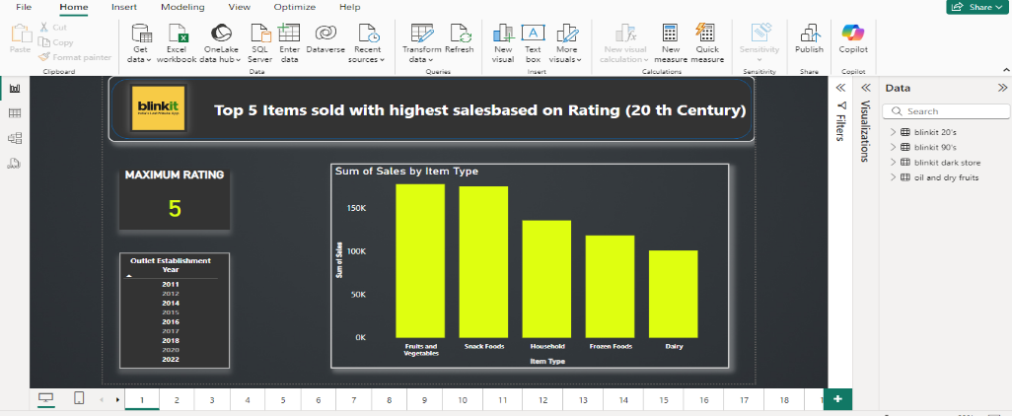
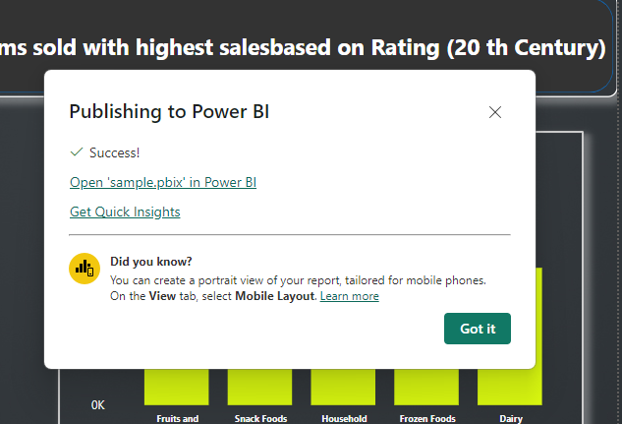
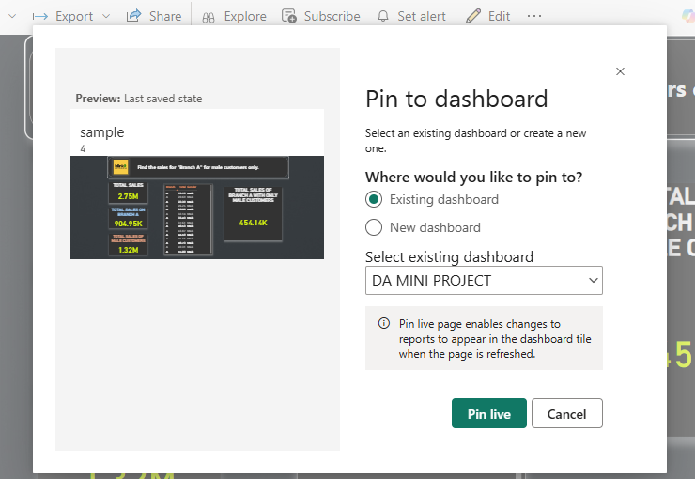
Process of creating Dash board
STEP 1
Open Power Bi serviced in web browser.
Sign in to your work or school account.
Click Publish option .
STEP 2
Now select visuals from Power Bi file created and imported to dashboard.
Create new dashboard named “BLINKIT SALES ANALYSIS”.
Then pin them to the dashboard.
STEP 3:
CREATING A NEW DASHBOARD

Slide 38
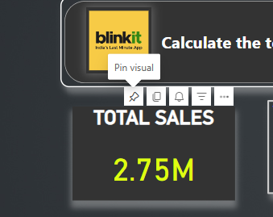
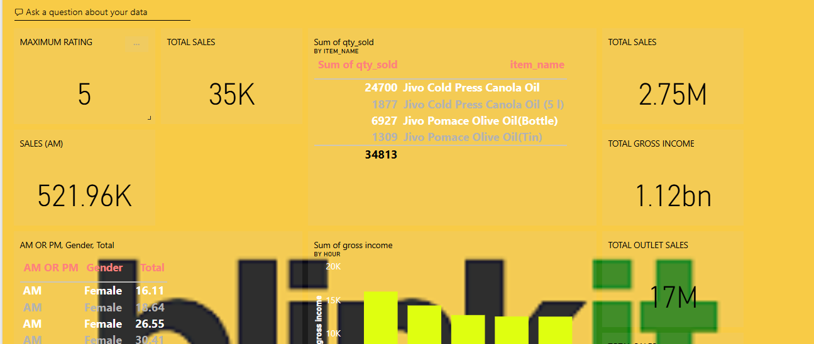
Process of creating Dash board
STEP 4
Pin the Visuals
DASH BOARD VIEW OF BLINKIT SALES DATA ANALYSIS :

